Slide 1
Housing Recommendations for Ames, Iowa realtors
By Taylor J. Simpson

Slide 2

Agenda
Business Problem
Background Info
Data Cleaning
Exploratory Data Analysis
Findings
Recommendations

Slide 3

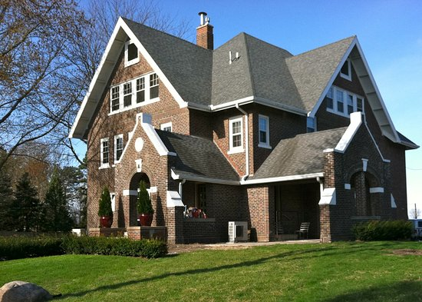
Business Problem
How should houses be appropriately priced?
What features are most important to a house’s value?
What models can be used to set up best chance for profitability for realtors?

Slide 4


Background of Ames, Iowa
The median house has 4.8 rooms and 1.7 bathrooms, and has a value of $187,000
The median income for households in Ames, Iowa is $42,755, while the mean household income is $63,199.
Population Growth has increased by 1.27% per year on average over the last 5 years
Demographic breakdown is skewed by students- average age of 23.1
“Silicon Prairie” and ranked 53 on the Livability list

Slide 5

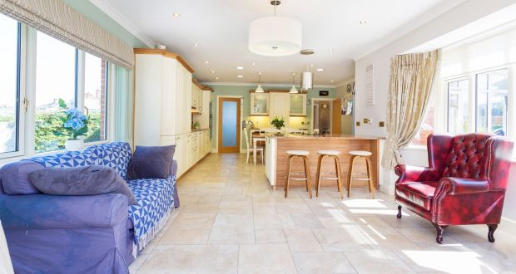
Data Cleaning
Data Cleaning
Import, format, predict, re-start, EXPLORE
Python
Repetition and problem solving

Slide 6
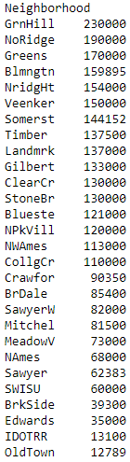
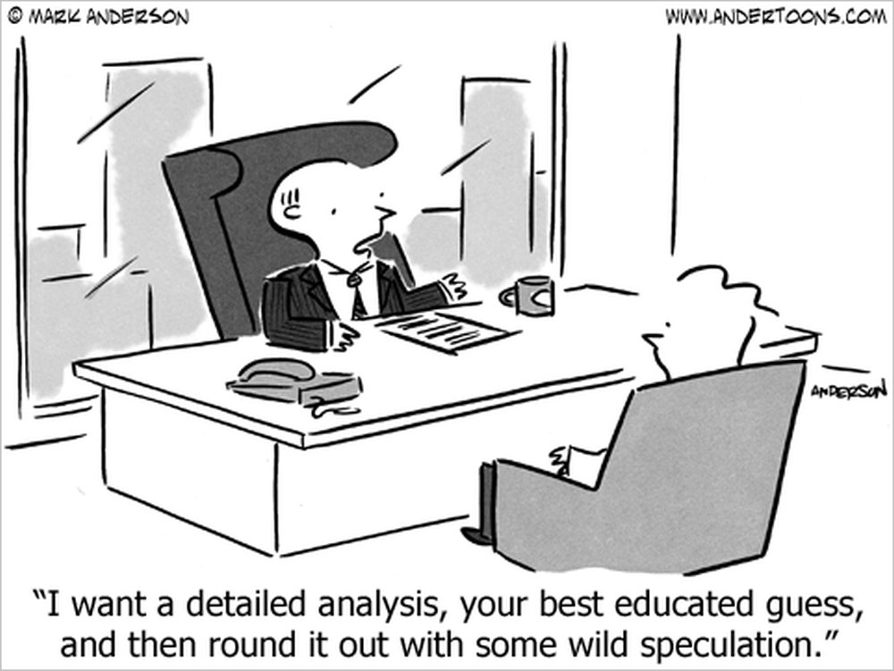
Exploratory Data Analysis

Slide 7

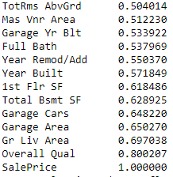
Results and Analysis- Features
Features of a home most valuable
Overall Quality
Gr Living Area
Features of a home least valuable
Parcel ID
Enclosed Porch
Year Sold
GENERAL- pool area

Slide 8
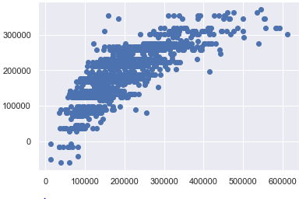
Results and Analysis – Linear Regression
Linear Regression
Actual Price
Correlation | .6493
Intercept | -114,408.63
Coefficient | array([44187.28771101, 9073.15163331])
Predicted Price based on features

Slide 9
Recommendations
Tell homeowners to invest in quality and add square footage
Always consider neighborhood before agreeing to take on client
Use this model to set your expected price
Consider external factors like market conditions and housing comps, and set a stretch price and lowest acceptable price
Use model
3 Tiered Pricing
Wait
$$$

Slide 10

Questions?...

Slide 11
Bibliography
https://datausa.io/profile/geo/ames-ia/
https://www.areavibes.com/ames-ia/demographics/
https://www.nar.realtor/determining-asking-price
https://docs.google.com/spreadsheets/d/1FpHhgowgiOkHHnzMqbP3pNLLqPP4yIgnP2bCxwGPpGE/edit?usp=sharing

